Slide 1

Blockchain Technology
BCSBT603

Slide 2
Module 1: Blockchain Topics to be covered ….
Distributed System
CAP Theorem
Byzantine Generals Problems
Introduction to blockchain
Various technical definitions of blockchains
General elements of blockchain
Features of blockchain
Applications of blockchain
Tiers of blockchain
Benefits and limitations of Blockchain
Consensus
Types of Blockchain

Slide 3
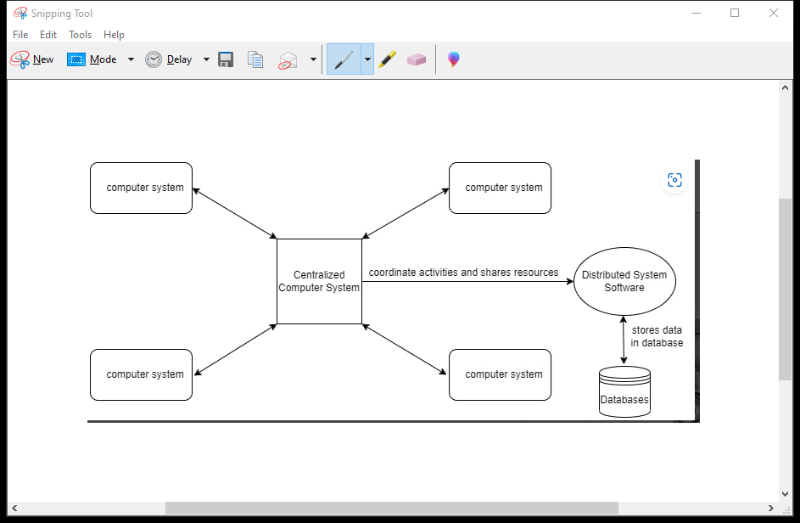
Distributed systems
Two or more nodes work with each other in a coordinated fashion in order to achieve a common outcome.

Slide 4
Node can be:
individual player
sending and receiving messages
honest,faulty, or malicious
Memory and processor
Exhibit arbitrary behavior - Byzantine node.
Challenge in distributed system
Coordination
Fault tolerance
Desired result

Slide 6
Examples for Distributed systems
Telephone and Cellular systems
Wireless sensor networks
Routing algorithm
Peer to peer networks
Multiplayer online games
Virtual reality communities

Slide 7
CAP theorem
The theorem states that any distributed system cannot have Consistency, Availability, and Partition tolerance simultaneously.
This is also known as Brewer's theorem.
Distributed systems are so challenging to design so that all the features cannot be fulfilled simultaneously.
Consistency → Same data everywhere .
Immediate Replication.
Broadcast to all nodes.
Availability →Always accessible,
Responsive node.
Working nodes.
Partition tolerance→ Regardless of the breakdown in the communication between the nodes it continues the functional.

Slide 8
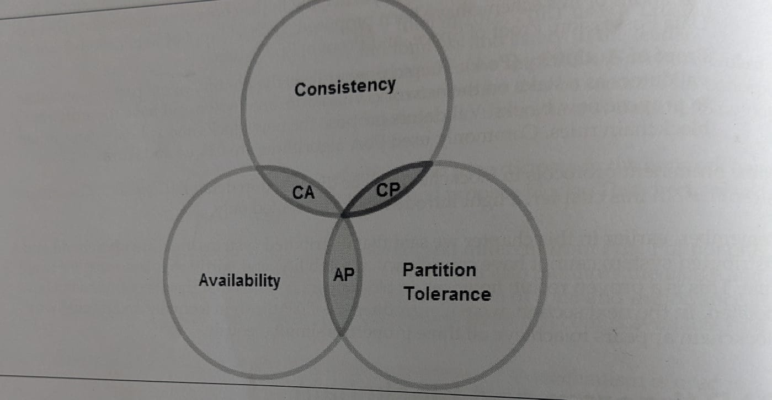

Slide 9
Byzantine Generals problem
Compared to the distributed system where the traitor is compared to Byzantine node, Generals to nodes and messenger to the communication channel.
Basically, in a distributed system it is difficult to rely on the single truth as the identity of a person cannot be verified.
This problem was solved with the implementation of Proof Of Work(POW) algorithm to achieve consensus.

Slide 10
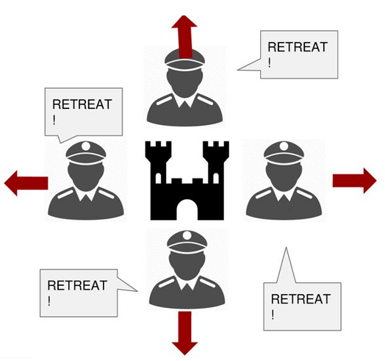

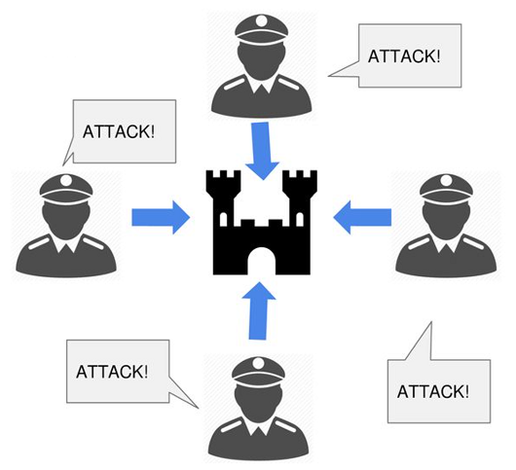
Byzantine Generals problem
Byzantine generals were about to attack the city.

Slide 11
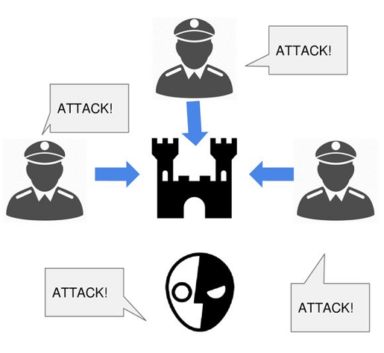
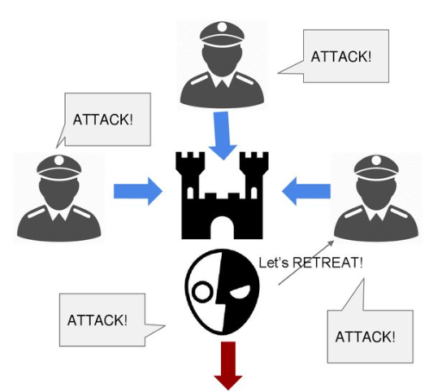
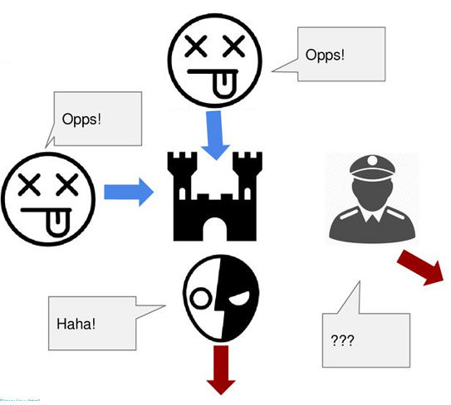
Byzantine Generals problem

Slide 12
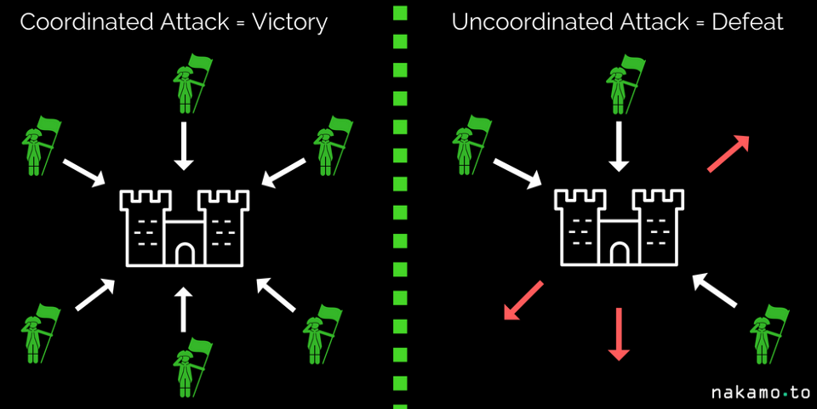
Byzantine Generals problem
Over come BGP : Byzantine Fault Tolerance (PBFT)

Slide 13
Introduction to blockchain
The network view of a blockchain

Slide 14
Blockchain technology is an advanced database mechanism that allows transparent information sharing within a business network. A blockchain database stores data in blocks that are linked together in a chain.
Blockchain at its core is a peer-to-peer distributed ledger that is cryptographically secure, append-only, immutable (extremely hard to change) and updateable only via consensus or agreement among peers.

Slide 15
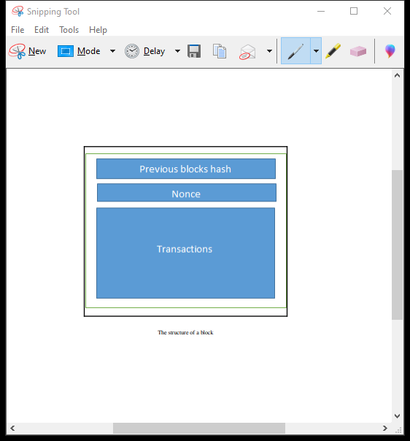
STRUCTURE of BLOCK

Slide 16
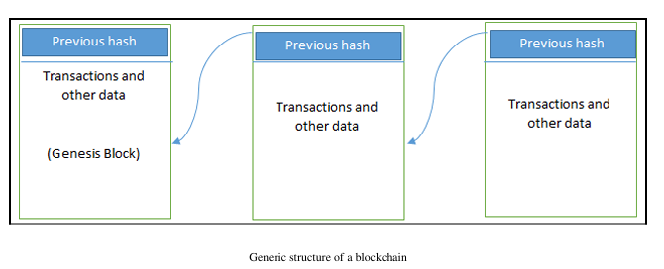
STRUCTURE OF THE GENESIS BLOCK

Slide 17
Nonce: Number only used once is a unique, random or semi-random number that is used only once in cryptographic communications.
Transaction refers to the transfer of information or value between participants on the network.
Hash : Unique code will be generated.

Slide 18
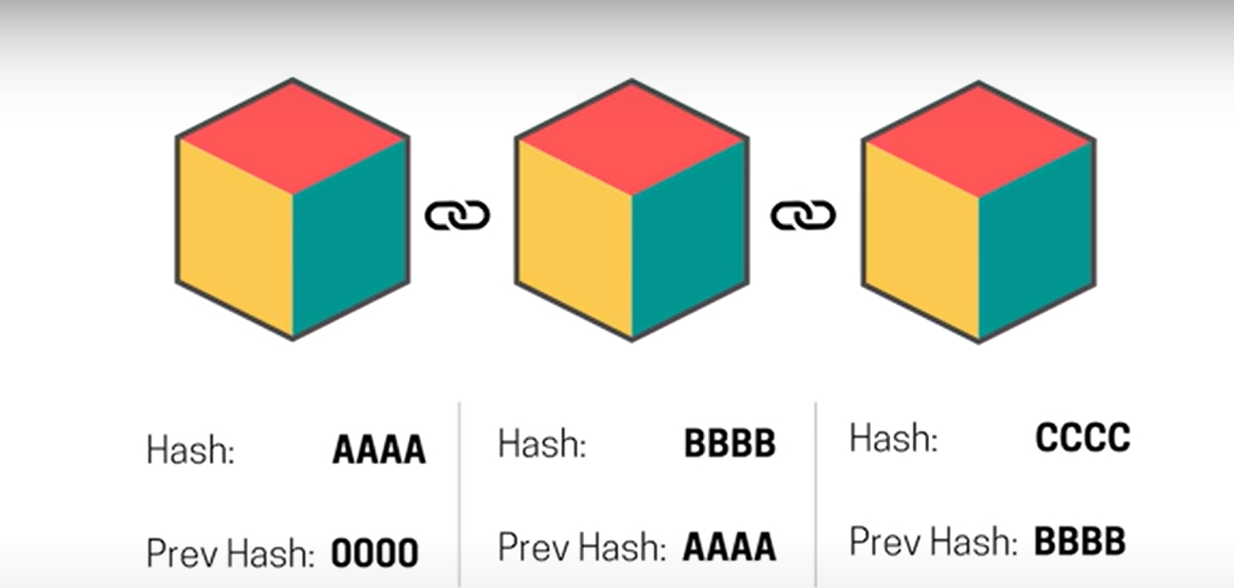

Slide 19
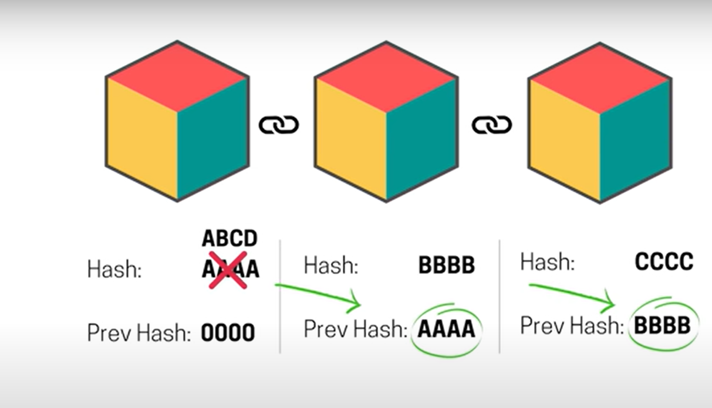

Slide 20
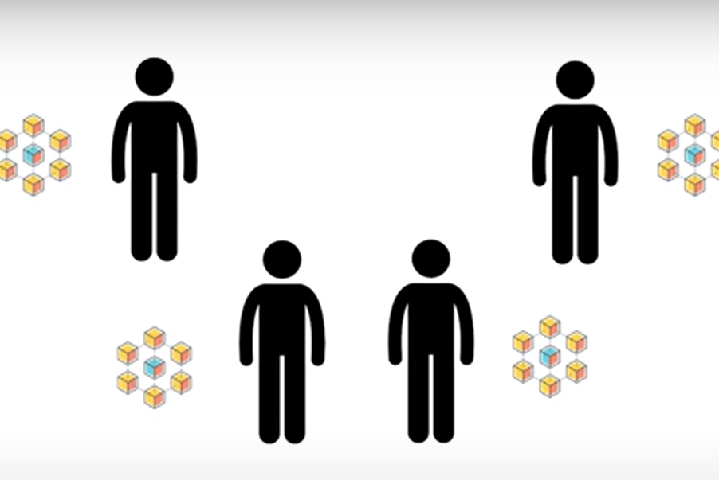
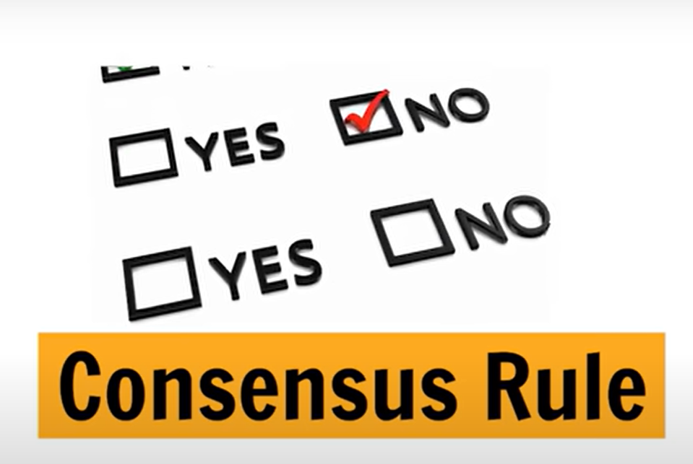

Slide 21
Various technical definitions of blockchains
Blockchain is a decentralized consensus mechanism.
eventually come to an agreement regarding the state of a transaction.
Blockchain is a distributed shared ledger.
Blockchain can be considered a shared ledger of transactions. The transaction are ordered and grouped into blocks.
Blockchain is a data structure; it is basically a linked list that uses hash pointers
instead of normal pointers.

Slide 22
Applications of blockchain technology
Money transfers
Insurance
Real estate
Secure personal information
Voting
Government benefits
Securely share medical information
Logistics and supply chain tracking

Slide 23
Tiers of blockchain technology
Blockchain 1.0 : cryptocurrencies, core applications such as payments.
Blockchain 2.0 : financial services and contracts are introduced.
Blockchain 3.0 : more general-purpose industries such as government, health,media, the arts, and justice.
Generation X : one day we will have a public blockchain service available that anyone can use just like the Google search engine

Slide 24
Generic elements of a blockchain
1.Addresses:
unique identifier→identifies the sender and recipients.
It is a public key and it is unique.
Users generate a new address for each transaction.
2. Transaction:
It is the fundamental unit of blockchain.
It is a unique identifier that represents a destination where cryptocurrency or data can be sent and received.
It represents the transfer of value from one address to another.

Slide 25
3.Block:
A block is composed of multiple transactions and some other elements such as the previous block hash (hash pointer), timestamp, and nonce.
4.Peer-to-Peer network:
As the name implies, this is a network topology whereby all peers can communicate with each other and send and receive messages.
5.Scripting or Programming Language:
Transaction scripts are predefined sets of commands for nodes to transfer tokens from one address to another and perform various other functions.

Slide 26
6.Virtual Machines:
It is a software platform; which is more like a virtual computer that is used by developers in order to create decentralized applications.
Eg: Ethereum VM, Chain VM
7.State machine:
A blockchain can be viewed as a state transition mechanism whereby a state is modified from its initial form to the next and eventually to a final form as a result of a transaction execution and validation process by nodes

Slide 27
8.Nodes:
A node in a blockchain network performs various functions depending on the role it takes.
A node can propose and validate transactions and perform mining to facilitate consensus and secure the blockchain.
9.Uniqueness:
This feature of blockchain ensures that every transaction is unique and has not been spent already.
10.Smart Contracts:
It is the guidelines between the peers.
It is executed between the peers once the transaction is initiated.

Slide 28
Features of a blockchain
Distributed consensus : This enables a blockchain to present a single version of truth that is agreed upon by all parties without the requirement of a central authority.
Transaction verification : Any transactions posted from nodes on the blockchain are verified based on a predetermined set of rules and only valid transactions are selected for inclusion in a block.
Platforms for smart contracts : A blockchain is a platform where programs can run that execute business logic on behalf of the users.
Transferring value between peers : Blockchain enables the transfer of value between its users via tokens. Tokens can be thought of as a carrier of value.
Generating cryptocurrency : A blockchain can generate cryptocurrency as an to its miners who validate the transactions.
Smart property : you are in full control of your asset and it cannot be double spent or double owned. The double spend problem was first solved in bitcoin.

Slide 29
Features of a blockchain
Provider of security : Blockchain is based on proven cryptographic technology that ensures the integrity and availability of data.
Immutability : This is another key feature of blockchain: records once added onto the blockchain are immutable.
Uniqueness : This feature of blockchain ensures that every transaction is unique and has not been spent already.
Smart contracts : These are automated autonomous programs that reside on the blockchain and encapsulate business logic and code in order to execute a required function when certain conditions are met.

Slide 30
Benefits and limitations of blockchain
Decentralization
Transparency and trust
Immutability
High availability
Highly secure
Simplification of current paradigms
Faster dealings
Cost saving

Slide 31
Benefits and limitations of blockchain
1.Scalability:Limiting the number of transactions happening over the network.
2.Adaptability:Adapting to the technological advancements and new use cases.
3. Regulation: Regulations can limit the ability of blockchain-based businesses to innovate and experiment with new ideas.
4. Relatively immature technology :Blockchain technology is still considered a relatively new and immature technology, as it has only been around for about a decade.
5.Privacy:The lack of privacy on public blockchains can limit adoption, as some businesses or individuals may be hesitant to use .

Slide 32
TYPES OF BLOCKCHAIN
1.Public Blockchain
2.Private Blockchain
3.Semi private Blockchain
4.Sidechain
5.Permissioned Ledger
6.Distributed Ledger
7.Shared Ledger
8. Fully private and proprietary blockchains
9. Tokenized blockchains
10.Tokenless blockchains

Slide 33
Types of blockchain
1) Public blockchains :
Most of the time we use public blockchain.
open to the public and anyone can participate.
It is also called as permissionless blockchain.
Any node which is part of blockchains should verify and validate.
2) Private blockchains :
It is also called as permission blockchain/Managed blockchain.
Its controlled by a single organization.
Centralized node determination.
open only to group of individuals or organizations ,that has decided to share ledger among themselves.
Partial Decentralization.

Slide 34
3) Semi-private blockchains :
Part of the blockchain is private and part of it is public.
The private part is controlled by a group of individuals .
whereas the public part is open for participation by anyone.
4) Sidechains :
The basic idea of sidechains is to create a new blockchain network that is connected to an existing blockchain, usually through a two-way peg mechanism.
This enables assets to be transferred between the main blockchain and the sidechain allowing for greater flexibility and interoperability.
They are 2 types :
One way pegged sidechain:
Two way pegged Sidechain:

Slide 35
5) Permissioned ledger :
participants of the network are known and already trusted.
Permissioned ledgers do not need to use a distributed consensus mechanism, instead an agreement protocol can be used.
No requirement for permissioned Blockchain to be private , it can be public but with regulated access control.
Provide greater privacy compared to public.
6) Distributed ledger :
ledger is distributed among its participants and spread across multiple sites or organizations.
Each computer in the network (known as a node) has a copy of the ledger, which is updated in real-time as new transactions are added.
This type can either be private or public.

Slide 36
7) Shared ledger :
Each participant in the network has access to the same copy of the ledger.
Any application or database that is shared by the public.
Shared ledgers are often used in business-to-business transactions, where multiple parties need to track the movement of goods, payments, or other assets
8) Fully private and proprietary blockchains :
Blockchains have no mainstream application as they deviate from the core idea of decentralization in blockchain technology.
For example, for collaboration and sharing data between various government departments.

Slide 37
9) Tokenized blockchains :
Blockchains are standard blockchains that generate cryptocurrency as a result of a consensus process via mining.
10) Tokenless blockchains :
Probably not real blockchains.
lack in basic unit of transfer of value but are still valuable in situations.
They are still valuable in situations where there is no need to transfer value between nodes and only sharing some data among various already trusted parties is required.

Slide 38
CONSENSUS
Consensus is the agreement between two nodes in a network.
Following are the requirements for achieving consensus in the DS.
Agreement: All the nodes agree upon the same value.
Termination:All honest nodes terminate execution of the consensus process and eventually reach a decision.
Validity: The value agreed upon by all honest nodes must be the same as the initial value proposed by at least one honest node.
Fault tolerant: The consensus algorithm should be able to run in the presence of faulty or malicious nodes (Byzantine nodes).
Integrity: This is a requirement whereby no node makes the decision more than once. The nodes make decisions only once in a single consensus cycle.

Slide 39
The following are the consensus algorithms
1.Proof of work(PoW)
2.Proof of Stake(Pos)
3. Delegated Proof of Stake.
4. Proof of Elapsed Time.
5. Deposit-based consensus
6. Proof of importance
7. Federated consensus or federated Byzantine consensus.
8. Reputation-based mechanisms.
9. Practical Byzantine Fault Tolerance.

Slide 40
1) Proof of work(PoW):
Concept
Introduced by Bitcoin (Satoshi Nakamoto).
Miners compete to solve complex mathematical problems (cryptographic puzzles).
The first miner to solve the puzzle gets to add a new block to the blockchain and is rewarded with cryptocurrency.
How It Works
Transaction Validation – Transactions are collected and broadcasted to the network.
Mining Competition – Miners use computational power to solve a cryptographic hash function (SHA-256 for Bitcoin).
Block Addition – The first miner to solve the puzzle adds a block to the blockchain.
Network Agreement – Other nodes verify the solution, and if valid, the block is permanently recorded.

Slide 41
Advantages
✔️ Highly secure against attacks (e.g., 51% attack is extremely costly). ✔️ Fully decentralized – no need for a trusted authority.
Disadvantages
❌ Energy-intensive – requires a vast amount of electricity. ❌ Slow transactions
❌ Mining centralization risk – Large mining pools dominate the network.
Examples
🔹 Bitcoin (BTC) 🔹 Litecoin (LTC) 🔹 Ethereum (before ETH 2.0 update)

Slide 42
2) Proof of Stake(Pos):
Concept
Instead of using computational power, validators are chosen based on the number of coins they "stake".
More staked coins = higher chances of being selected to validate transactions.
How It Works
Users stake coins in a special smart contract.
A validator is randomly selected based on stake size and other factors.
Validator confirms transactions and adds a new block.
Rewards are given in the form of transaction fees or new coins.

Slide 43
Advantages
✔️ Energy-efficient – no mining hardware required. ✔️ Faster transactions than PoW. ✔️ Encourages long-term holding – reduces volatility.
Disadvantages
❌ Wealth-based – the rich (who stake more) get richer. ❌ Potential for centralization – fewer validators control the network.
Examples
🔹 Ethereum 2.0 (ETH) 🔹 Cardano (ADA) 🔹 Polkadot (DOT)

Slide 44
3) Delegated Proof of Stake:
Concept
In DPoS, token holders (or stakeholders) in the network can delegate their voting power to a select group of validators (or delegates) to validate transactions and create new blocks on their behalf.
How It Works
Users stake tokens and vote for trusted delegates.
Elected delegates validate transactions and create new blocks.
Block rewards are shared between validators and voters.

Slide 45
Advantages
✔️ Very fast transaction speeds. ✔️ More democratic than standard PoS (users can vote). ✔️ Energy-efficient like PoS.
Disadvantages
❌ Risk of cartel formation – a small group of delegates can gain control. ❌ Less decentralized than PoW.
Examples
🔹 EOS 🔹 TRON (TRX) 🔹 Steem

Slide 46
4) Proof of Elapsed Time:
Concept
In PoET, each node in the network generates a random wait time and competes with other nodes to complete the wait time.
The node that completes the wait time first is granted the right to create a new block on the blockchain.
How It Works
Each participant gets a randomized wait time.
The first to complete the wait time gets to add a block.
Prevents monopolization of validation rights.

Slide 47
Advantages
✔️ Efficient and fair – random selection avoids manipulation. ✔️ Ideal for enterprise use cases.
Disadvantages
❌ Requires specialized hardware (Intel SGX). ❌ Not used for public blockchains.
Examples
🔹 Hyperledger Sawtooth

Slide 48
5) Deposit-based consensus:
Concept
In this consensus algorithm, participants are required to deposit a certain amount of cryptocurrency as collateral to participate in the network.
If a participant acts maliciously or attempts to manipulate the network, their deposit can be taken away or "slashed" as a penalty.

Slide 49
6) Proof of importance:
Concept
In PoI, participants are assigned a "importance score" based on their activity on the network.
such as the number of transactions they have made and the amount of cryptocurrency they hold.
Also the number of other users they have brought into the network.
Validators are then selected based on their importance score to validate transactions and create new blocks on the blockchain.

Slide 50
7) Federated consensus or federated Byzantine consensus:
Concept
In FBC, a group of pre-selected nodes or organizations are designated as validators and are responsible for maintaining the network's security and reaching consensus on transactions and new blocks.
These validators are required to communicate with each other and reach a consensus on the validity of each transaction and block before it is added to the blockchain.

Slide 51
8) Reputation-based mechanisms:
Concept
In a reputation-based consensus algorithm, participants are assigned a reputation score based on their activity and behavior on the network.
This score is calculated based on various factors, such as the number of transactions they have made, the amount of cryptocurrency they hold, and their overall behavior and reputation within the network.
Validators are then selected based on their reputation score to validate transactions and create new blocks on the blockchain.

Slide 52
9) Practical Byzantine Fault Tolerance:
Concept
Practical Byzantine Fault Tolerance (PBFT) is a consensus algorithm used in some distributed systems to tolerate failures and ensure that a distributed network can reach consensus despite the presence of malicious nodes.
a group of pre-selected nodes, known as replicas, are responsible for validating transactions and creating new blocks on the blockchain.
PBFT is a powerful consensus algorithm because it allows the network to reach consensus even in the presence of a significant number of faulty or malicious nodes.

Slide 53
S.No. | Proof of Work (PoW) | Proof of Stake (PoS)
1. | The probability of mining a block is determined by how much computational work is done by miner. | The probability of validating a new block is determined by how large of a stake a person holds (how many coins they possess).
2. | A reward is given to first miner to solve cryptographic puzzle of each block. | The validator donot receive a block reward instead they collect network fee as their reward.
3. | To add each block to chain, miners must compete to solve difficult puzzles using their computer process power | There is no competition as block creator is chosen by an algorithm based on user stake.
4. | Hackers would need to have 51% of computation power to add malicious block. | Hackers would need to own 51% of all cryptocurrency on network, which is practically impossible.

